Slide 1
Friday, September 23, 2016
Write In Your Agenda:
Write In Your Monitoring Log:
CW:
It’s Not My Fault
My Faults
HW:
Study for Boundaries Quiz on Tuesday.
Response to Warm-Up:
What are the three types of boundaries?
You will need:
Pencil

Slide 2
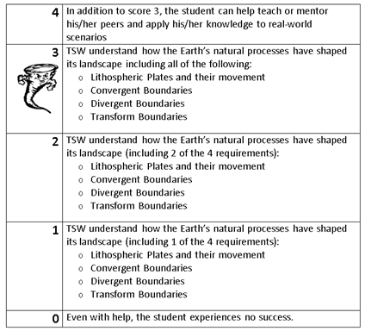
Learning Goal and Scale
TSW understand how the Earth’s natural processes have shaped its landscape (including Lithospheric Plates and their movement, Convergent, Divergent, and Transform boundary landforms).

Slide 3
https://www.youtube.com/watch?v=KCSJNBMOjJs

